Slide 1
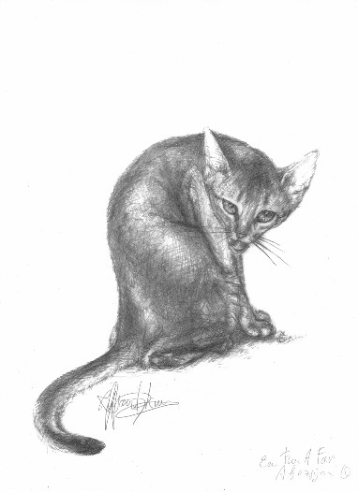
The Abyssinian Breed History of the Abyssinian

Slide 2
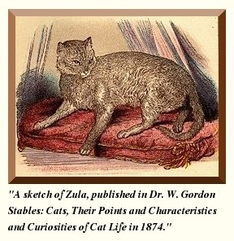
HISTORY OF THE ABYSSINIAN

Slide 3
Cat Mummies British Museum
Cats were the exclusive animal of the goddess Bast, also known as Bastet. Bastet was the goddess of love and war and was believed to appear on earth as a cat, and as a result, the cats were immensely regarded and worshipped in ancient Egypt.
The British Museum has a considerable collection of cat mummies which clearly indicates the important position that the cat held in the land of the Pharaohs.

Slide 4
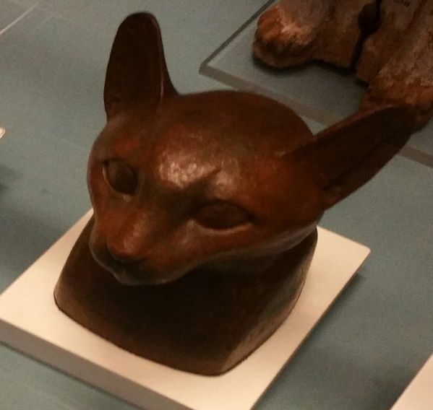
Mystery of the Abyssinian Cat
In their booklet published in 1951, Child Of The Gods, Helen and Sidney Denham, refer to the Abyssinian as a “Child of the Gods” Sidney Denham explains, “It may well be that the religious beliefs of ancient Egypt are forever alive, and in the Abyssinian cat of today we have the reincarnation of a divinity”!

Slide 5
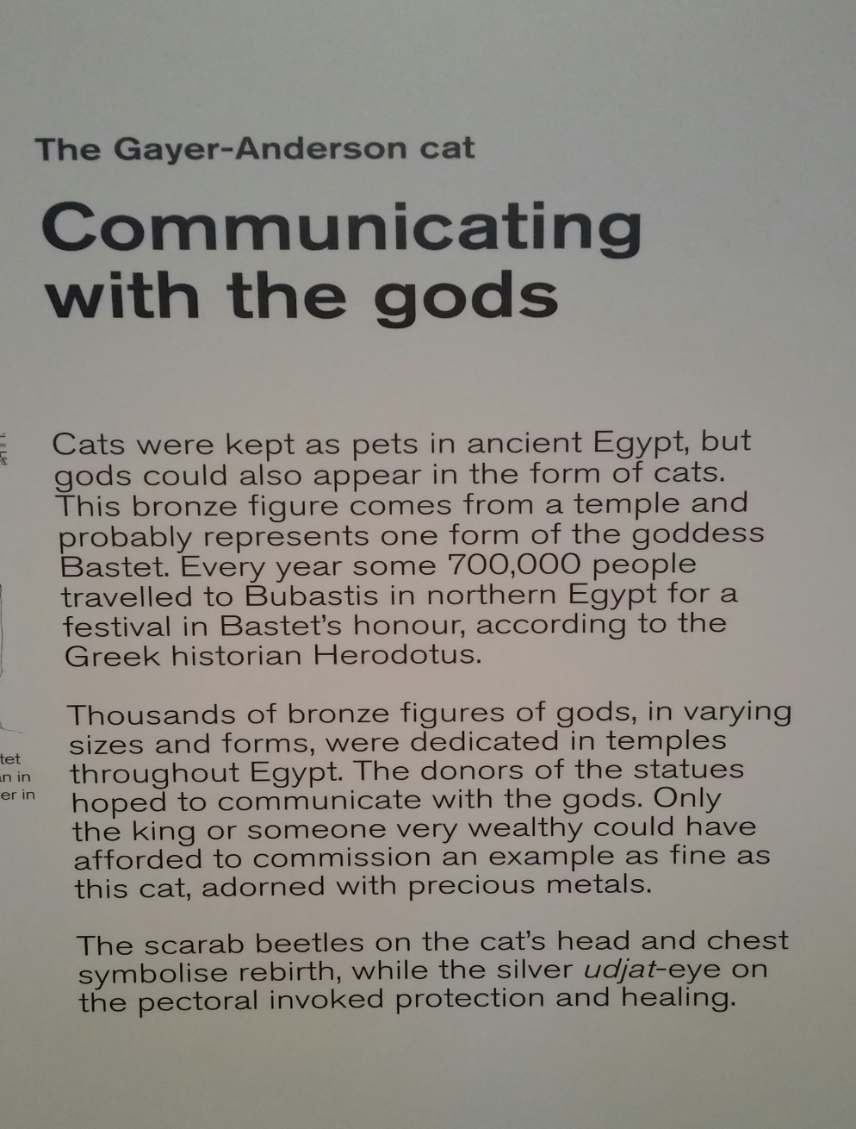
The Grayer-Anderson Cat British Museum
Bronze with silver plaque and gold jewelry. Around 600 BC.
Possibly Saqqara, Egypt

Slide 6
Considered to be the oldest breed of the cat family
Brian Vesey-Fitzgerald in his book ‘Cats”, points out that by viewing Egyptian art, the idea that the Abyssinian may very well existed at that time is prevailing. Egyptian bronzes and paintings of cats in ancient Egyptian emphasize the litheness, elegance, graceful lines, large eyes, rounded contours, long tail with tabby stripes and alert ears which are distinguishing features that are seen in the Abyssinians of today.

Slide 7
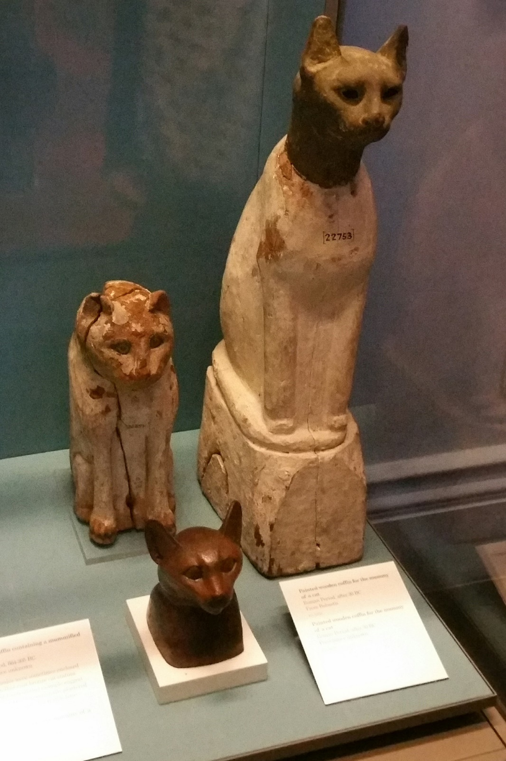
There are those who are of the belief that the idea of the Abyssinian being a direct descendant of the sacred cat of Ancient Egypt is only a romantic tale.

Slide 8
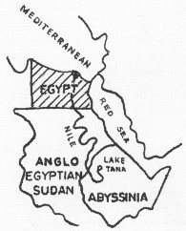
Journey from Abyssinia to Egypt
Many believe there was a close link between Abyssinia and Egypt and the potential for the Abyssinian cat to be part of both cultures was very possible. Having the same ruler at times created a connection that allowed both countries to be influenced by one another. In the fourth century, Abyssinia accepted the Coptic Christian faith of Egypt and the head of the Ethiopian church was appointed by the patriarch of the Coptic church in Egypt. Another important fact is that the Nile river allowed for communication and trade. The Blue Nile in Abyssinia’s Lake Tana, joining the White Nile flowing northward towards Egypt.

Slide 9
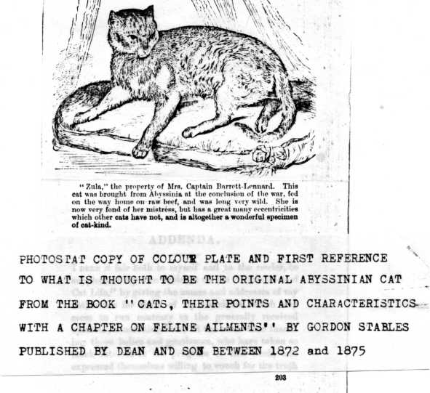
Zula
Others believe that an Abyssinian named Zula was transported by British soldiers from Abyssinia (now Ethiopia) to England at the end of the Abyssinian war in 1868. Many believe Zula to be the foundation of the Abyssinian however, there is no documentation linking Zula to the Abyssinian breed lines.

Slide 10
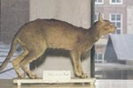
Patrie: Leiden Zoological Museum
More recent genetic studies have identified the potential forbearers of the Abyssinian may have come from the coast of the Indian Ocean and parts of Southeast Asia. Leiden Zoological Museum in Holland has on display a ruddy ticked feline taxidermy which was purchased in the mid 1830s, and labeled as Patrie, domestica India. This indicates the possibility that the breed may have been introduced into England from India by colonists or merchants who frequently traveled between England and the Indian subcontinent.

Slide 11
Bunny Cat
Some others believe that the English developed the Abyssinian by crossing silver and brown tabbies with the British ticked “Bunny” cats.

Slide 12
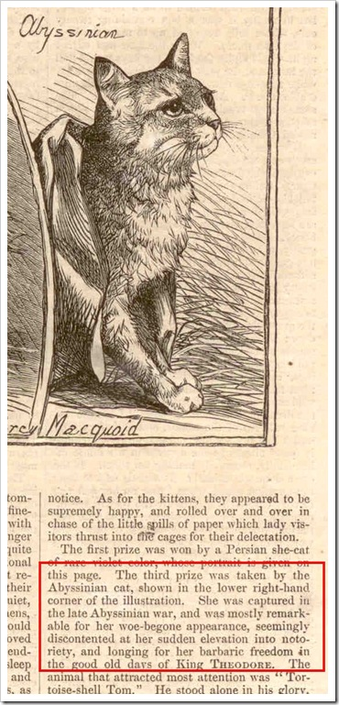
Zula, the Abyssinain wins 3rd prize Crystal Palace, UK
The first mention of an Abyssinian was in the January 27, 1872 issue, Harper's Weekly where the 3rd prize in the December, 1871 Crystal Palace show was taken by the Abyssinian Cat ("captured in the late Abyssinian War"). This article is accompanied by an illustration of the Abyssinian Cat. The description reads: "Zula, the property of Mrs. Captain Barrett-Lennard. This cat was brought from Abyssinia at the conclusion of the war..."

Slide 13
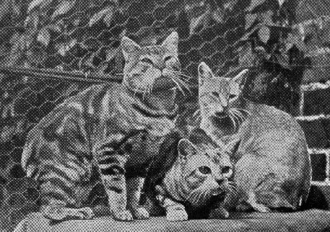
Sedgemere Bottle & Sedgemere Peaty Owned/Bred By Sam Woodiwiss
First Pair to gain fame in England were Bottle & Peaty. (Center & Right .. A Manx to Left) The first Abyssinian registrations occurred in 1896, and the stud book of the National Cat Club reveals that Sedgemere Bottle, born in 1892, and Sedgemere Peaty, born in 1894, were registered by Mr. Sam Woodiwiss.

Slide 14
Largest Abyssinian Catteries in England
Woodrooffe Cattery: Major Sydney Woodiwiss
Croham Cattery: Mrs. Clare Basnett
The foundation of the American Abyssinian as we know it came from these two catteries. During the Second World War, catteries struggled and became small due to the food shortages and the fear of being bombed. It is documented that only twelve Abyssinians survived World War Two, although there were imported Abyssinians already in the US. Through it all, the Abyssinian lines were able to move forward.

Slide 15
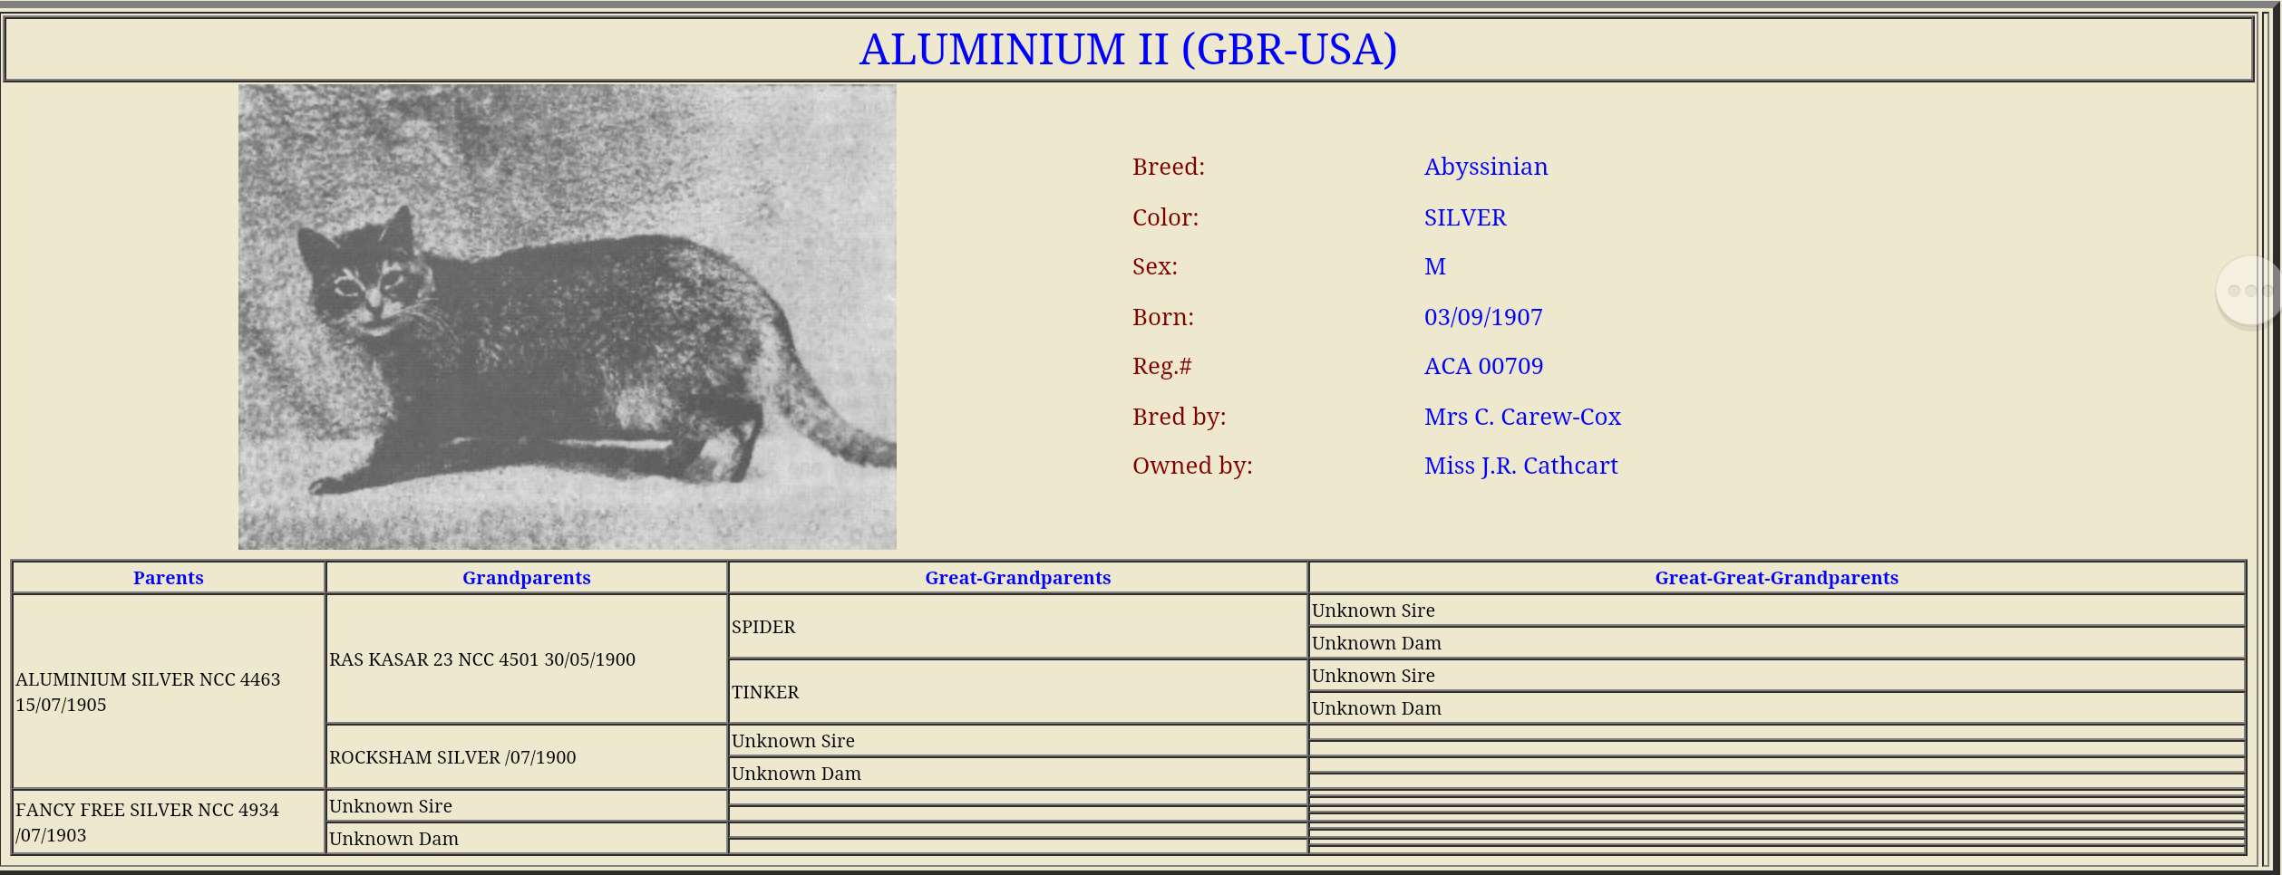
Aluminium II
Aluminum II was born on September 2, 1907, and was acquired by Miss J.R. Cathcart of the United States. Miss Cathcart also obtained another cat, a female named Salt. According to Mrs. Zanetti (Zanetti, Dennis, and Hantzmon, 1906) Aluminum II and Salt were the first imports to the United States.

Slide 16
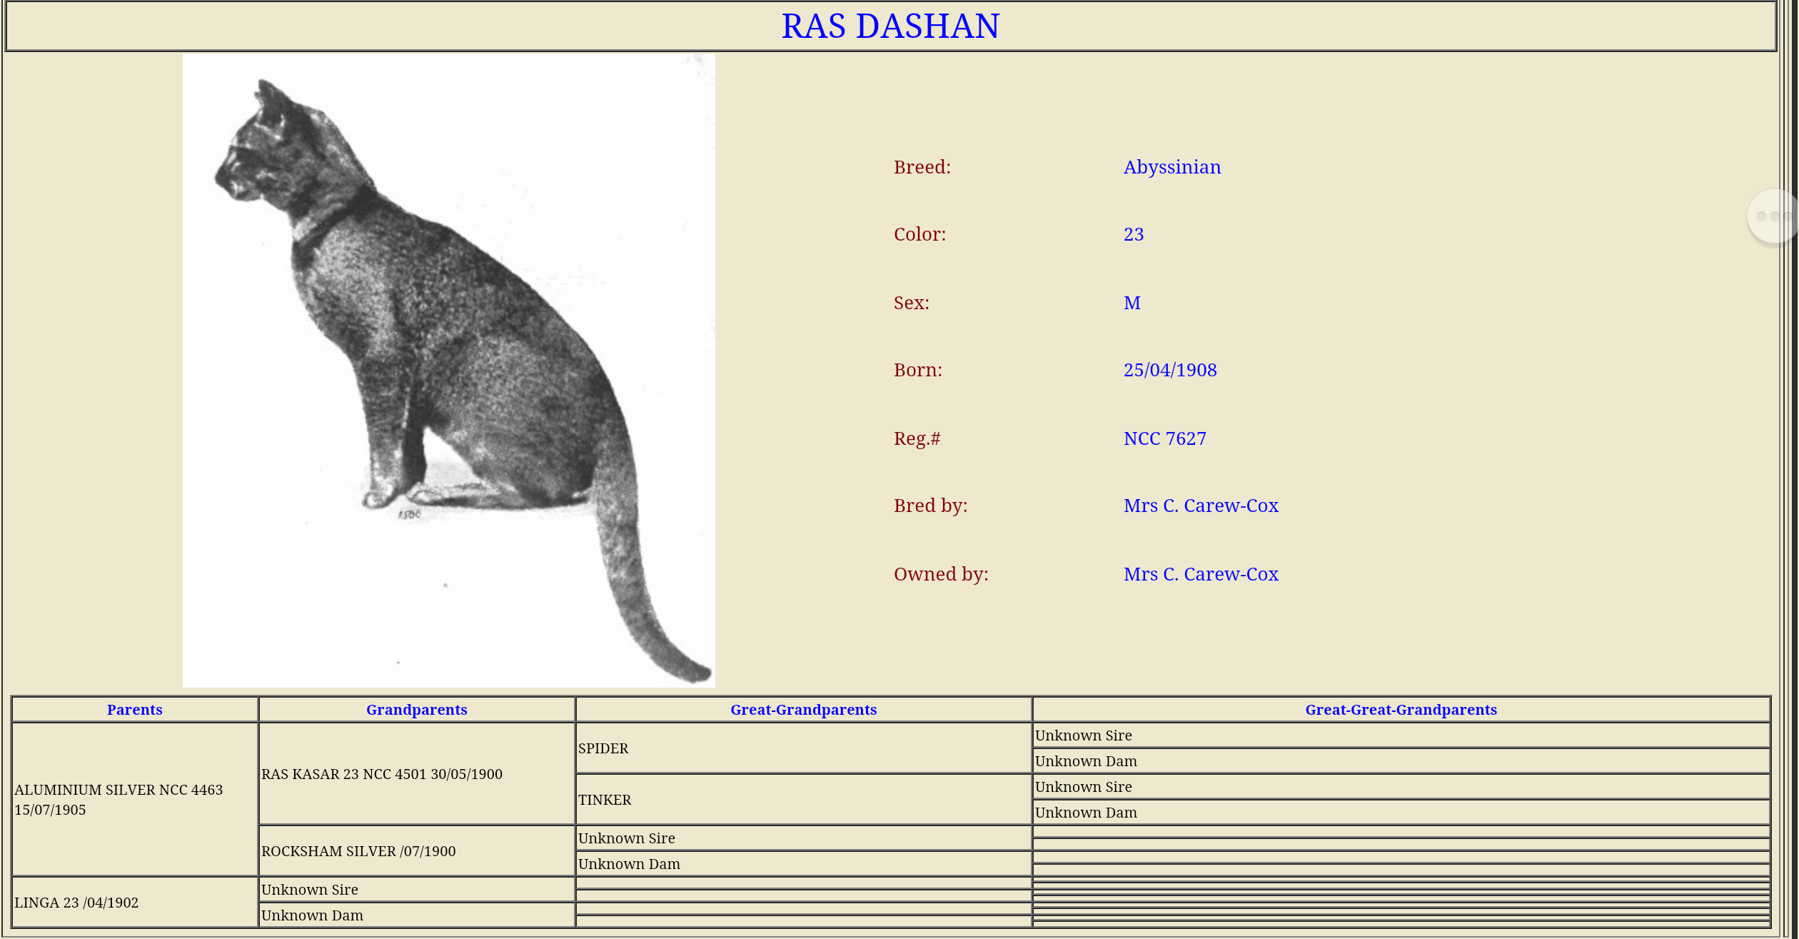
Ras Dashan: Son of Aluminium II & Linga
Note the Color: 23 - Ruddy color.
Sire was a silver & the Dam was a ruddy ( 23)

Slide 17
Woodrooffe Ena of Newton
From 1920 until 1934 no trace of Abyssinians could be found in the US. Miss Mary Hantzmon of Washington DC, acquired Ena, a ruddy female and since there were no males available, in 1937 she imported a male stud from England named Ras Seyum.

Slide 18
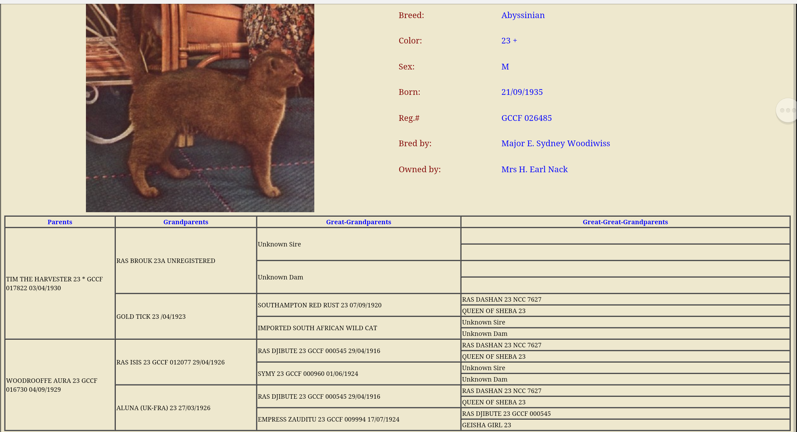
Ras Seyum
Ras Seyum was known to be the most impressive Abyssinian to date. He was considered quite handsome, very well ticked, with a intense reddish brown color; lovely body and faultless head type.

Slide 19
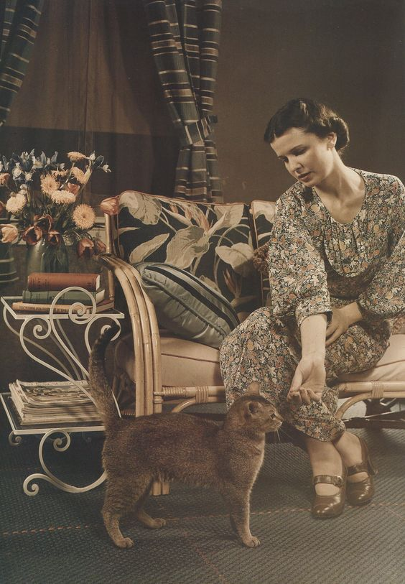
Ras Seyum
A color picture of Ras Seyum appeared in the November 1938 Issue of National Geographic Magazine. At that time he was considered The Best Abyssinian in Great Britain. Many were disappointed that he was imported to the United States.
Notes:
See National Geographic November 1938

Slide 20
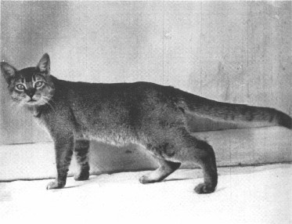
Original Abyssinian Cat Club of Great Britian
The first cat registry was the National Cat Club, established in 1887 in England.
The first Abyssinian Club was founded in 1929 primarily to promote the pure breeding of the Abyssinian Cat. This club was also one of the first members of the Governing Council of the Cat Fancy (GCCF)

Slide 21
1889 Abyssinian Breed Standard Great Britain
Head (10 Points) Small, broad across the eyes, rather long than short, nose medium length, all well-formed
Eyes (15 Points) Orange-yellow, slightly tinged with green, large, round, full, and bright
Nose and Feet (10 Points) Nose dark red, edged with black; tips and cushions of feet black, also the back of the hind-legs
Fur (15 Points) Soft, rather woolly hair, yet soft, silky, lustrous, and glossy, short, smooth, even, and dense
Ears (10 Points) The usual size of the ordinary English cat, but a little more rounded, with not much hair in the interior, black at the apex
Colour (20 Points) A rich, dun brown, ticked with black and orange, or darker on lighter colours, having a dark or black line along the back extending to the end of the tail, and slightly annulated with black or dark colour. As few other marks as possible. Inside of fore-legs and belly to be orange-brown. No white
Size and Condition (10 Points) Large; coat glossy and smooth, fitting close to the body; eyes bright and clear
Carriage and Appearance (10 Points) Graceful, lithe, elegant, alert and quick in all its movements, head carried up, tail trailing, in walk undulating
N.B. - The Abyssinian Silver Gray, or Chinchilla, is the same in all points, with the exception of the gound color being silver instead of brown. This is a new and beautiful variety.

Slide 22
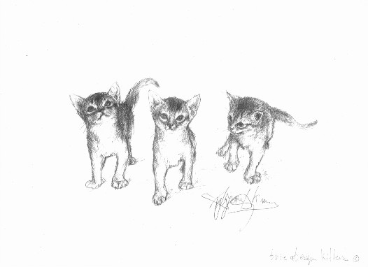
First Abyssinians to be Shown in the USA
In the USA, the 1899 Chicago Cat Club was formed, followed by the Beresford Cat Club (named after noted British breeder Lady Marcus Beresford). In 1906, the American Cat Association became the main registry and in 1908 this became the Cat Fanciers' Association Inc. (CFA).
There is evidence to believe that the first “recorded” Abyssinians that were shown in America were Silver in color. They were shown in Boston, Massachusetts in 1909 and were owned by Miss Jane Cathcart of Oradell, New Jersey.
The reason why it is believed that they were silver is by the very nature of the their names; Champion Aluminum and Salt.
In 1920, Boston Cat Club had a classification for Abyssinians.

Slide 23
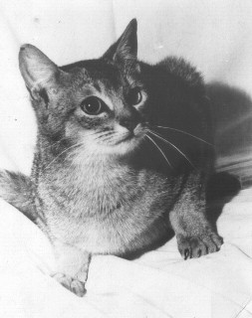
Abyssinians in the USA
Since 1937 when Woodroofe Ena and Ras Seyum arrived from England, so began the Abyssinian reign in the United States. Even though the Abyssinian had been seen in previous cat shows, many consider this to be the true beginning.
In the late 1930’s Mr. Charles Johnson of Philadelphia acquired two imported kittens. Mrs. Blanche Warren of California imported several Abyssinians as well. In the 1940’s Dr. and Mrs. Fairchild of California also bred the Abyssinian and became well known for promoting the breed.

Slide 24
Abyssinians in TICA
Abyssinians were one of the original breeds that was accepted in TICA at its inception on June 22nd of 1979.
TICA's first show was "A Midsummer Night's Dream" held at Fort Lewis, near Tacoma, Washington, on July 28, 1979.

Slide 25
Abyssinian Colour Standards
Abyssinian Colour Standards:
23 – Usual Abyssinian Overall Appearance: Rich Golden brown ticked with black Base Hair: Ruddy orange or apricot Ticking Colour: Black Nose leather: Brick red Pads: Black
23a – Sorrel Abyssinian Overall Appearance:- Lustrous copper ticked with chocolate Base Hair: Bright apricot Ticking Colour: Chocolate Nose Leather: Pink Pads: Pink.
23c - Blue Abyssinian Overall Appearance:- Soft warm blue ticked with deeper blue-grey Base Hair: Pinkish mushroom Ticking colour: Blue-grey Nose Leather: Dark pink Pads: Mauvish-blue.
23b – Chocolate Abyssinian Overall Appearance:- Rich copper brown ticked with dark chocolate Base Hair: Rich apricot Ticking Colour: Dark chocolate Nose leather: Pinky-chocolate Pads: Chocolate
23d - Lilac Abyssinian Overall appearance:- Warm (pinkish) dove grey ticked with deeper dove grey Base Hair: Pinkish-cream Ticking Colour: pinkish-dove grey Nose Leather: Mauvish-pink Pads: Mauvish-pink
23e – Fawn Abyssinian Overall appearance:- Warm fawn ticked with deeper fawn Base Hair: Fawny cream Ticking colour: Fawn Nose Leather: Pink Pads: Pink

Slide 26
Ruddy ( Usual) & Red (Cinnamon)
Breeding in England focused on the development of the ticked (Agouti) coat, and over time the undesirable tabby marking were bred out. Records indicate that Abyssinians first bred in England were of a Silver or Yellow ticking color, as evidenced by Abyssinians pedigrees of Aluminium and Gold Tick in the early 1900’s. Breeding became focused on bringing out a warmer color, hence the Sorrel (red) and Ruddy (usual) of today.

Slide 27
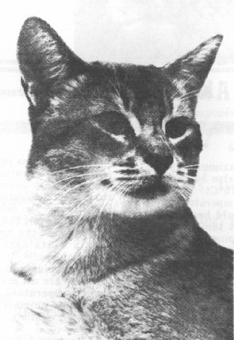
Blue
In 1968 a blue Abyssinian kitten, Fairlie Mehesso, bred by Mrs. Stock, appeared at the West of England and South Wales Cat Society's show at Cirenceste. The blue Abyssinians are produced by combining the diluting gene with a ruddy. Many believe that the diluting gene may have been present in the Abyssinan all along and that the gene was “hidden”. An Abyssinian male, Raby Ashanto, who was born in 1942, carried this gene because interbreeding with his descendents produced some of the earliest blues. Though the blue was present since 1968, the 1980’s is where we start to see them become more prevalent.

Slide 28
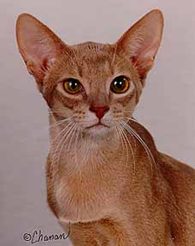
Fawn
The first Abyssinian to be proven to carry the blue gene was probably the English male Raby Ashanto, born in 1942. Almost all of today’s blue and fawn Abyssinians can be traced back to him.
The fawn is a dilute version of the Cinnamon appearing as a dark cream and copper, oat warm rose-beige, ticked with light cocoa brown, the extreme outer tip to be the darkest, with blush beige undercoat. Tail tipped with light cocoa brown. The underside and inside of legs to be a tint to harmonize with the main color.

Slide 29
Silver Abyssinians -1900’s
Mr. H.C. Brooke, an early British Abyssinian breeders opposed the silver color and, in order "to get back the warmth of body color," used a cat he described as a "self red" in breeding program. In the beginning, Abyssinians were, indeed, silver cats accompanied by remnants of tabby markings. At a time when silver and brown tabbies were truly popular in England, breeders tried to produce a totally distinctive cat. They introduced a little red to warm up the coat as Mr. Brooke did, and they bred out the tabby markings.

Slide 30
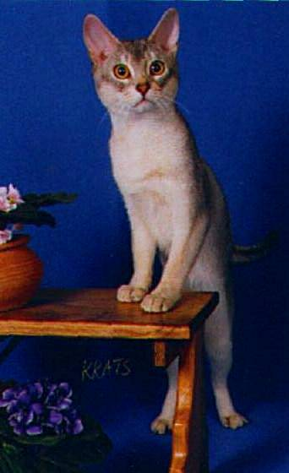
Silvers
Since the early 1900’s silver Abyssinians have been popular in the USA when two silver Abyssinians , Aluminum & Salt were imported from a British breeder. The silver gene is an inhibiting gene and makes the undercoat of an Abyssinian a silvery-white color.
In 2001, TICA accepted all four silver colors into their championship division. In June of 2001, in Ft. Worth, TX, Sterlingsilver Daylily became the first blue silver female Abyssinian champion in the nation. Pictured here is Sterlingsilver Sir Christopher, a blue silver Abyssinian male.

Slide 31
Chocolate & Lilacs
The first chocolate & lilac Abyssinian kittens were imported from the UK in early 2000. It is believed that all of today's chocolate and lilac Abyssinians are descended from a chocolate Abyssinian named Arboreal Chocolate Katrina who was produced from this outcross According to TICA’s existing standard, the colors were accepted along with the ruddy, sorrel, blue and fawn. This was due to the addition of “eumelinistic “ in the standards.
Notes:
NEED TO ADD MORE REGARDING THE COLOR CHANGES IN THE 2000-2003/ UCD >> SEE NOTES FROM NANCY PARKINSON

Slide 32
Chocolate & Lilac
The kittens pictured below were the first of the lilac and ch0colate colors to hold a championship title in TICA in the US. The kittens were owned by Bruce Alexy, Alexy Abyssinians, Greensboro, NC.

Slide 33
Abyssinian Today
Over the centuries, the Abyssinian has developed into one of America’s favorite breeds. Aloof, mysterious, regal, lithe & graceful; known for their rather large ears and lustrous almond eyes. Their devotion and affection make them an ideal companion.

Slide 34
Famous Abyssinians
Cinnamon, the first cat to have its entire genome published.
Punkin, an Abyssinian cat belonging to radio talk show host Rush Limbaugh.
Jackpot, an episode of “CSI" (season 4, episode 7) features a blue Abyssinian named Isis as a significant clue.
Jake, The Cat From Outer Space (a 1970s Disney movie) Jake's role was played by the brother and sister Abyssinian cats Rumpler and Amber.

Slide 35
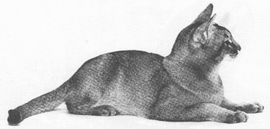
“All cats are smart, some of course are smarter than others and some are outstanding in intelligence, but for downright ability to outsmart a person every time, I give you the Abyssinian”.
Mrs. Fairchild, 1945

Slide 36
Interpretation of TICA Abyssinian Standard General Description
Coat, ticking, dramatic facial marking, like that of a cougar.
Deep, intense color with apparent four to six colored bands of color
Good resilient coat; medium in length, not too tight. Too tight of a coat will not allow for the bands of ticking that is essential to the breed.
Total clarity in the coat; no visible barring on neck and legs ( including inside of legs)
Ears are large but in proportion to the head; set as if listening.
Ears should not be too low on the head like an oriental but not straight up; there should be an in between the two extremes.
The head, including the ears should form a nice trapezoid.
Muzzle should have depth; not be too long but yet not to short
Gentle rounded curves; all transitions should be smooth
Eyes are almond shaped, not round.
Body should be medium in length, not tubular; nor oriental in shape
Rib cage should have some depth
Tail, legs and body should form a square.
Gentle curves; elegant musculature; Dancer like form
OVERALL BALANCE

Slide 37
Appearance of Abyssinians of Today Educational Viewpoint PART I
The interpretation of the Abyssinian over the years has become misconstrued by both breeders and judges and the ideal Abyssinian has become vague. The TICA standard is presently being reviewed by the current TICA breed committee with the intent to review, clarify and propose better defined descriptions of the Abyssinian so that a more precise guideline can be utilized. One of the areas being reviewed is the ears as the description is too ambiguous and needs to have a more specific representation.
Over the years there have been a variety of Abyssinians shown that typically follow the written standard. Unfortunately there have abys in recent years shown in the show hall that do not portray the Abyssinian illustrated in the TICA standards.
For example, oriental type Abyssinians with extremely low ears, slanted or rounded eyes, tubular bodies, straight (ski slope) profiles or squared muzzles. Little or no bands of ticking due to the fact of a short, tight coat. Along with this, extremely low white below the chin as well as quite pronounced , obvious barring. Sadly, this “type” of Abyssinian has not only been seen but has been winning.

Slide 38
Appearance of Abyssinians of Today Educational Viewpoint, PART II
An Abyssinian should not be oriental in type in any way. The head should be a modified wedge with rounded contours with a muzzle following gently contours and a profile without any flat planes. There should be no pinch in the muzzle, “foxy” look or be square at the end. Eyes should be almond in shape; not slanted or round.
Ears should be large, alert and set forward in a 45 degree angle, as if listening. They should be in balance with the head. They should not be too large, flared or have the look of “fly away ears”.
The body should be medium long, definitely not long and tubular. The aby should be elegant, graceful and muscular. Tail should be long and tapering, not whippy.
The legs should be svelte, long and muscular but not fine boned.
The coat should be medium in length, resilient and fine in texture. The coat should neither be tight or too short. The coat needs to have enough length to show the four to six bands of color. Too short of a coat will neither be resilient or show enough ticking. No barring is allowed.
Very important: An Abyssinian should be well balanced!

Slide 39
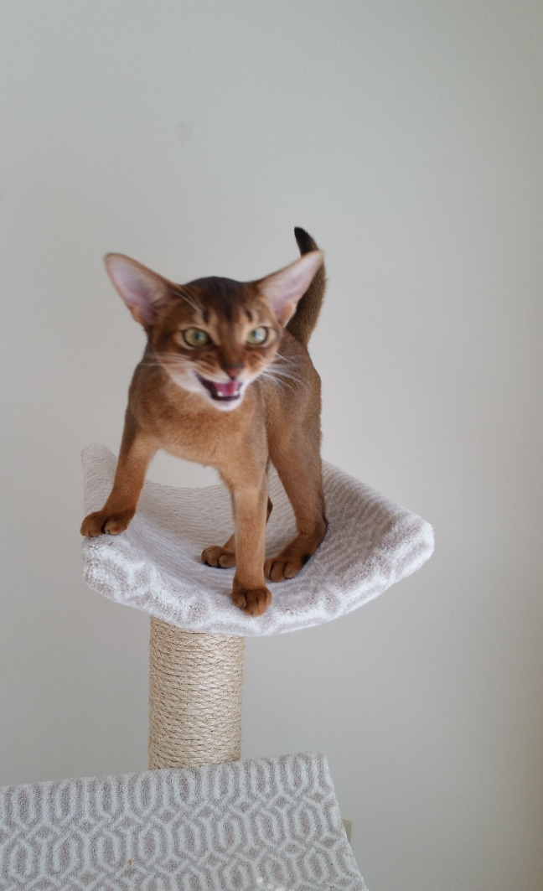
The Abyssinian Breed
Contributors: Marylou Anderson, Jean Hannum, Resa Bauer-DeMeyer, Brenda Russo
Presentation: Brenda Russo, TICA Breed Committee Chair
Jean Hannum, TICA Breed Committee

Slide 40
General Description
Alert & Active
Medium-sized
Well-muscled
“Mini Cougar”
Iridescent ticked coat
Graceful
Radiant, Regal
Feral appearing but gentle & playful

Slide 41
Breed Standard
The breed standard outlines the esthetic ideal toward which breeders strive to achieve.

Slide 42
Point Breakdown in the Standard
Breed Standard
Head - 35
Body - 35
Coat/color/pattern - 30
100 points = 100%
Notes:
Other associations count coat, color and body for more points and head for less.

Slide 43
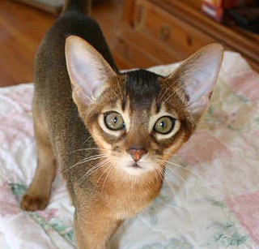
Breed Standard
Head - 35 Total Points
Shape 10
Ears 5
Eye Shape 5
Eye Color 5
Muzzle 5
Profile 5

Slide 44
Breed Standard
Shape (10 points)
Modified wedge with rounded contours
Not extreme or excessive
Rise from bridge of nose to forehead without evidence of a break
Gently curved forehead over the skull flowing into an arched neck
Roundness between the ears (not domed)

Slide 45
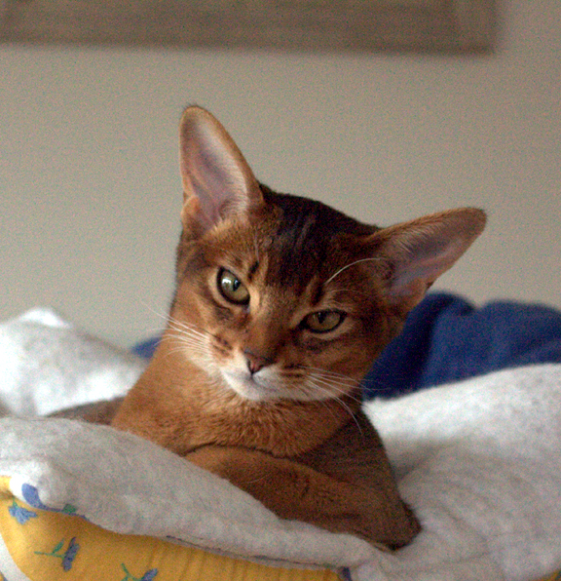
Head Shape

Slide 46
Head Shape
The Top of the Head must also be slightly curved – not flat and not domed.
The Abyssinian should have no sharp edges; everything must be curved, softened and rounded. The basic shape under the contours must be a modified wedge. A trapezoid with an oval transposition on top.
Notes:
Could look at a wedge as a trapezoid, but I like this aspect of the wedge because it has 3 sides instead of 4

Slide 47
Shape
Curved transition from the forehead over the skull flowing into an arched neck
Insert picture

Slide 48
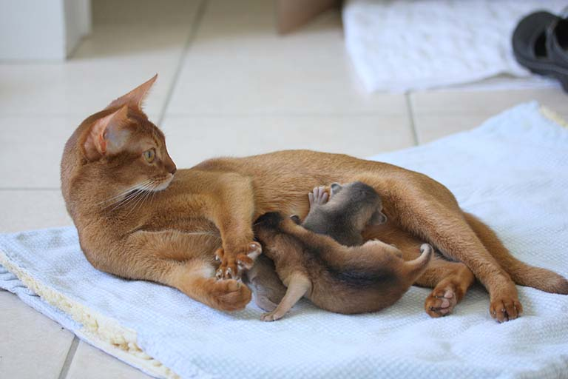
Good Chin
Strong, not protruding or receding

Slide 49
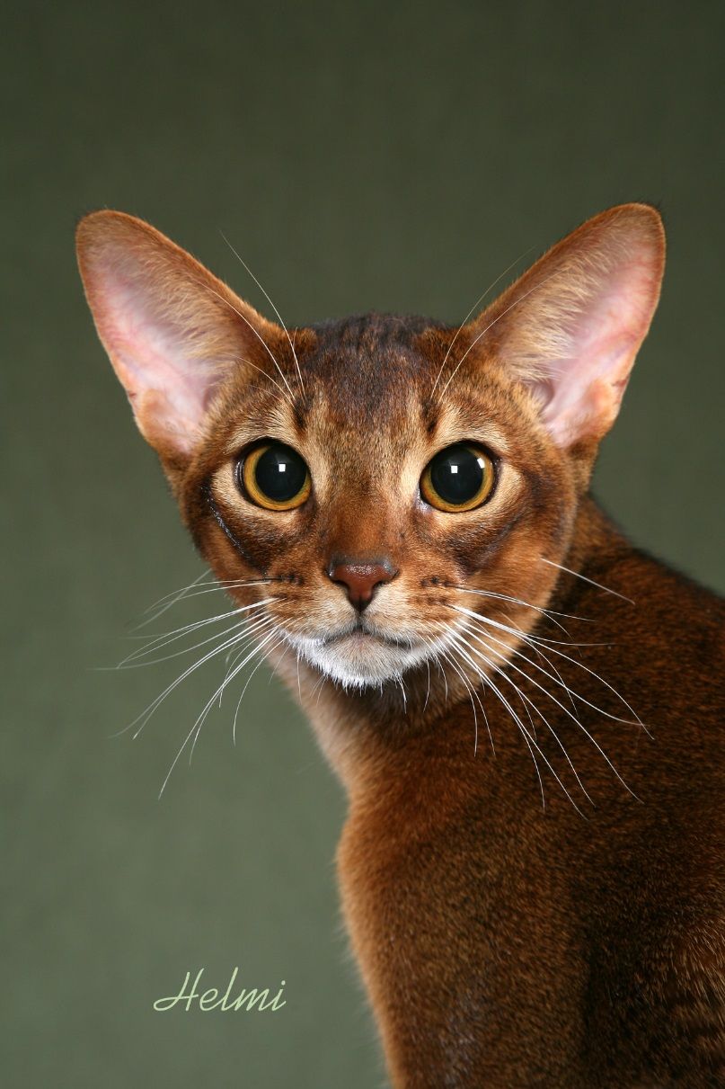
The Chin - viewed from the front
The chin can be viewed as an oval or almond in shape.

Slide 50
Breed Standard
Ears ( 5 points)
Large
Alert
Moderately pointed
Cupped at base & arched forward as if listening
May be able to discern a thumbprint marking on the back depending on color

Slide 51
Ears
The Standard does not address ear placement, but if it gives the appearance of an Oriental, it is not preferable.

Slide 52
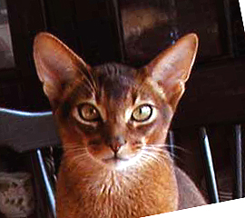
EARS

Slide 53
Ears

Slide 54
Ears are only 5 points on the Aby Standard, and yet they are an important part of the look. The ear must have a wide base and be cupped. The ear in profile should be tipped slightly forward - “as though listening.” The ear set viewed head on is not described in the Aby standard. This is something that the breeders need to agree on and add to the standard. However, in keeping with the modified wedge, I like the outside edge of the ear to follow the wedge and neither be too high (above the line of the wedge) nor too low (below the line of the wedge.)
EARS
Notes:
This is something that Aby breeders need to come to an agreement on.

Slide 55
Ear Set
The line of the modified wedge follows from the chin to just under the cheek bone to catch the outside border of the ear.
Notes:
This is the ear set that I find pleasing. Start in the center of the chin go straight to the bottom corner of the eye and keep going. MaryLou’s Clock idea.

Slide 56
Ears “set as though listening…”
Ears are arched forward and set as though listening.
Notes:
This is best done when the cat is in profile. Just let the cat follow the feather and get in the position where you can evaluate.
Mention a thumb print on the back of the ear. It is good to have the ear tipped in the color of the ticking.

Slide 57
Aby ears seem to grow smaller as the kitten grows into adulthood.
Adult ears can be the same size as a kitten’s ears, but on the kitten - the ears look larger because the head is smaller. Aby kitten ears can never be too large.
Notes:
I think a lot of breeders would agree with this.

Slide 58
Breed Standard
Eyes (Shape 5 points / Color 5 points)
Large
Almond-shaped
Brilliant & expressive
Eye color: gold, copper, green or hazel
Richness of color rewarded
No relation to coat color
Accented by ring of dark coloration on eyelids (eyeliner) surrounded by lighter colored area.

Slide 59
Eyes

Slide 60
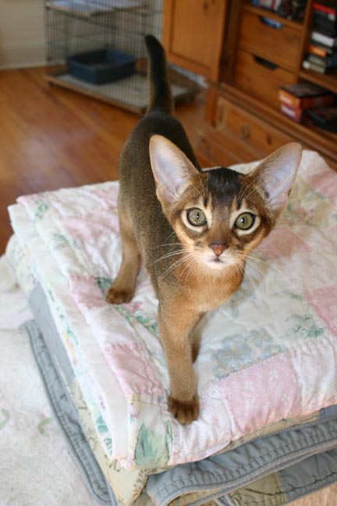
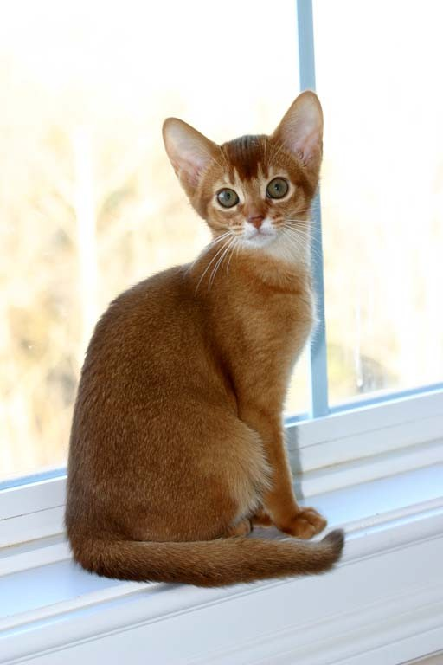
Aby Eyes: ALMOND not Round
Vivid facial markings highlight the dramatic look of well-shaped almond eyes. Also should not look oriental.

Slide 61
Eyes

Slide 62
Eye Color: Eye color to be “gold, copper, green or hazel.” Green eyes are seen in both the rufused and non-rufused/Silver Abys.

Slide 63
Breed Standard
Muzzle (5 points)
Rounded contours
Full chin
Perpendicular with nose
No pointiness, snippiness, foxiness
No whisker pinch
Not squared like the ASH

Slide 64
The Muzzle:
No evidence of snippiness, foxy appearance or whisker pinch
5 points

Slide 65
Muzzle

Slide 66
Breed Standard
Profile
Gentle curved transition between brow, nose and muzzle.
No flat planes

Slide 67
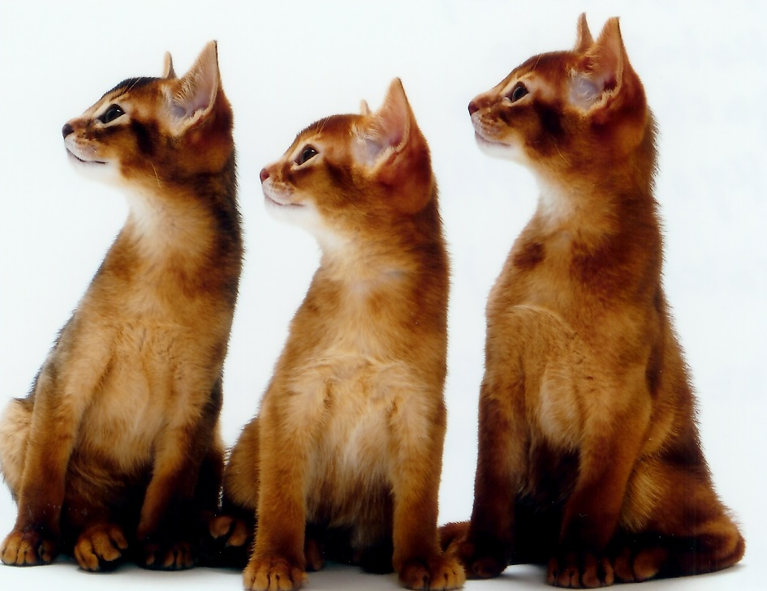
The Aby profile:
No flat planes…
Gently curving…
Curved transition between brow, nose and muzzle...

Slide 68
Profile

Slide 69
Breed Standard
Body - 35 Total Points
Torso 10
Legs/Feet 10
Tail 5
Boning 5
Musculature 5

Slide 70
Breed Standard
Torso (10 points)
Medium long – Foreign-type
Lithe & graceful balanced with the muscular strength of a fine-motor skilled athlete
Solid
Curved rib cage (not round)
Slight arch to back (more noticeable sitting)
Level flank
Proportion & balance preferred over size

Slide 71
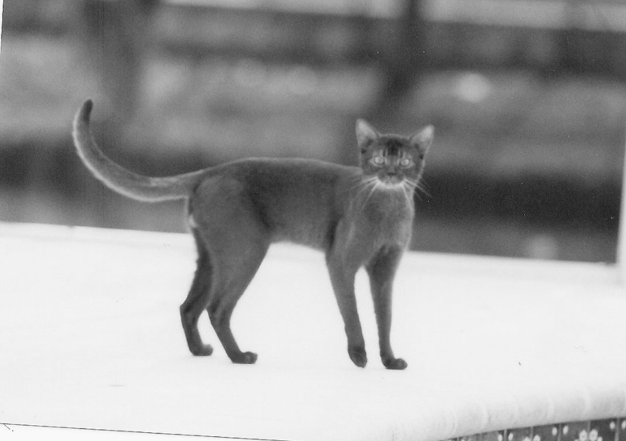
Torso: It’s Hip to be square…
Medium long
Lithe and graceful
Curved (oval) rib cage
Back -slightly arched
No tuck-up - almost level
Balanced
10 points
Balance in the Abyssinian means that the tail, legs and back should come close to being equal in length very much like a square.

Slide 72
Legs, Feet and Boning
Proportionately slim
Long
Well-muscled
Solid to the Feet
Feet Oval and on “tippy-toes”
15 points

Slide 73
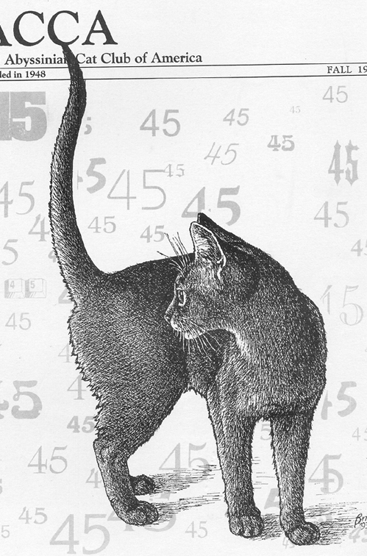
The Tail
5 pts
“Long and tapering” - in balance with the rest of the cat.
I would be hard pressed to find an Aby with a tail that was too long.

Slide 74
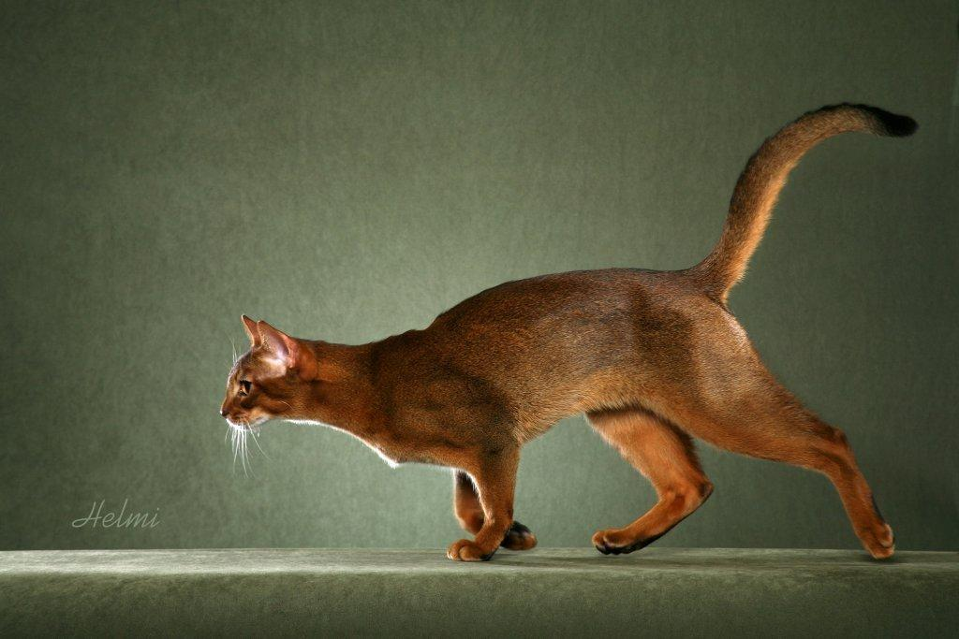
Torso
Happy medium between the extremes of cobby and the svelte long Oriental.

Slide 75
Torso

Slide 76
Breed Standard
Legs/Feet (10 pts)
Slim, not refined
Long
Well-muscled
Oval & compact feet – appear as if standing on “tippy-toe”.

Slide 77
Breed Standard
Tail
Long
Medium at base and tapering
Not thin or whippy

Slide 78
Breed Standard
Musculature
Well-developed strength without looking gross or coarse
Solidly built
Skin is minimally loose to allow for stretch jumping & climbing

Slide 79
Breed Standard
Coat/Color/Pattern
30 Total Points
Texture 10
Pattern 10
Color 10

Slide 80
Breed Standard
Abyssinian
Resilient – “snap back”
Lustrous sheen
Fine texture – soft
Medium length – long enough to accommodate 4-6 bands of ticking
Lies fairly close to body but without slickness
Longest along the spine line

Slide 81
Breed Standard
Color
Tabby Division
Warmth, rufousing, intensity
White only from very upper throat, chin to around nostrils & lips
Preference to good even ticking
Intensity of color should not diminish the ability to see the ticking
Ticking should not be sacrificed for depth of color

Slide 82
Breed Standard
Color/Ticking

Slide 83
Breed Standard
Traditional Category
1. Tabby Division
2. Silver/Smoke Division
Colors limited to the eumelanistic colors & agouti pattern only.
(Homozygous ticked tabby Ta/Ta)

Slide 84
Championship Divisions-Colors
Traditional Category
1. Tabby Division
2. Silver/Smoke Division
Colors limited to the Eumelanistic colors & Agouti pattern only.
(Homozygous ticked tabby)
Tabby Colors Silver/Smoke Colors
Ruddy Black Silver
Chocolate Chocolate Silver
Cinnamon Cinnamon Silver
Blue Blue Silver
Lilac Lilac Silver
Fawn Fawn Silver

Slide 85
Color
10 pts
“The colors of the Abyssinian in the Tabby Division should reflect warmth of color, giving the impression of a colorful cat.
The more color, the more rufusing - the better!! The “hotter” the undercoat color and the more intense the color of the color bands - the better. A dyed (“intent to deceive”) will not demonstrate the various “tones” in rufusing - the entire coat will show the same tone. In addition, a well colored (rufused) Abyssinian will enhance the ticking of the cat. Intense color should NEVER overcome the darker bands of ticking.
The colors of the Abyssinian in the Silver Division
The Silver Abyssinian ideally reflects NO warmth of color! The less rufusing – the better (Tarnishing). The exact opposite of the rufused Aby.

Slide 86
Penalize:
Color faults: Mouse (grey) down coat, broken necklaces, leg bars, uneven color in non-ticked areas, tabby stripes or bars, slick coat, plushy coat, incorrect paw pad color
Ticking/Pattern faults: Uneven ticking, lack of desired markings on head
Condition: Lack of condition, flabbiness of body (muscle tone), lack of coat luster, eye color, evidence of illness, emaciation and lack of muscle tone.
Notes:
“Distinct broken necklaces, leg bars, mottling or speckling in unticked areas (underside of body, chest and inside of legs), tabby stripes or bars.” This is most often referred to as “barring, trash, or jewelry.” These are the remnants of the body Tabby pattern that breeders try to eliminate.
Color or rufused smudges are less of a penalty than “black (ruddy), chocolate (cinnamon), grey (blue) barring. Fawn Abys rarely demonstrate any barring due to the lowered degree of color seen throughout the cat. Barring in the Fawn may be seen if the lighting is exceptional.
NO barring or neck marks are preferred. Aby breeders call this being ‘totally clear”.
“Cold, gray or sandy tone to coat color in ruddy, chocolate or cinnamon or grey hair next to the skin with absence of correct undercoat color.” This is most often referred to as “mouse coat.” Think of the color of the house mouse that raids your kitchen. Grey coloring NEXT TO THE SKIN is most often found at the nape of the neck, at the elbows, and at the outside of the rear legs/haunches.
I’d like to mention nose pad color as well -- Although I think that is covered in the Uniform color descriptions.
Wrong color or patching in the paw pads is extremely easy to determine. The paw pad will demonstrate a mottled or marbled appearance with a “wrong” color incorporated into the pad.
“Wrong color” in the paw pads is also quite easy to determine.
Ruddy: Any color other than black, brown, bluish black or brown.
Sorrel: Any color other than pink.
Blue: Any color other than Mauve - a greyish, bluish, pinkish.
Fawn: Any color other than pink with a bluish tone.
Slick coat is demonstrated due to lack of awn/undercoat. The Aby will exhibit a “tight or slick coat” with little or no resilience when the examiner runs his/her finger backwards through the coat. Excessive plushness or “wooliness” is demonstrated by a puffy, thick, British Shorthair-like coat. A very good but poorly groomed coat may appear to be too plush and stand away from the body.

Slide 87
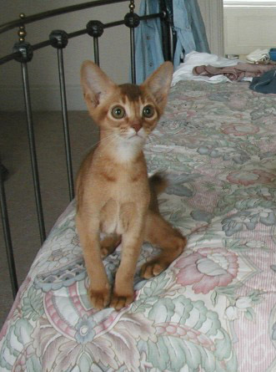
Ruddy kitten demonstrating coat/color issues
Low white
Smudges or ghost marks
Ghost marks on the leg
Notes:
These could all clear up as the kitten enters adulthood. If the marks were BLACK, they would be true bars.

Slide 88
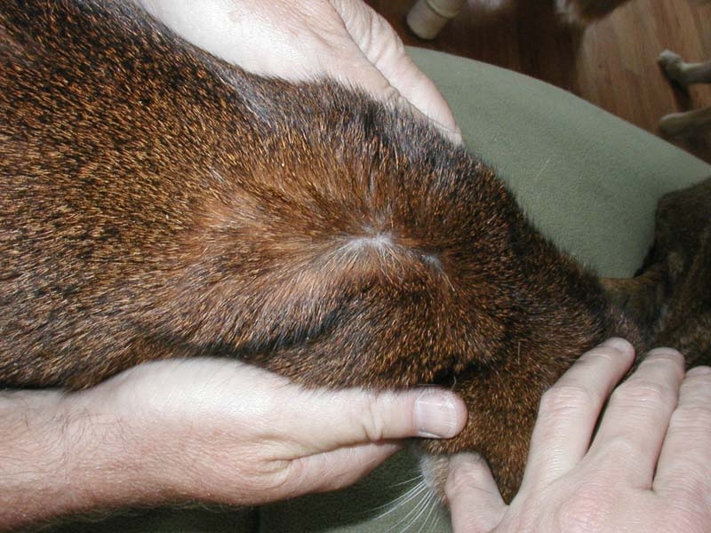
“Mouse” or grey down undercoat is found next to the skin and most often found on the neck, elbows and outside rear legs.

Slide 89
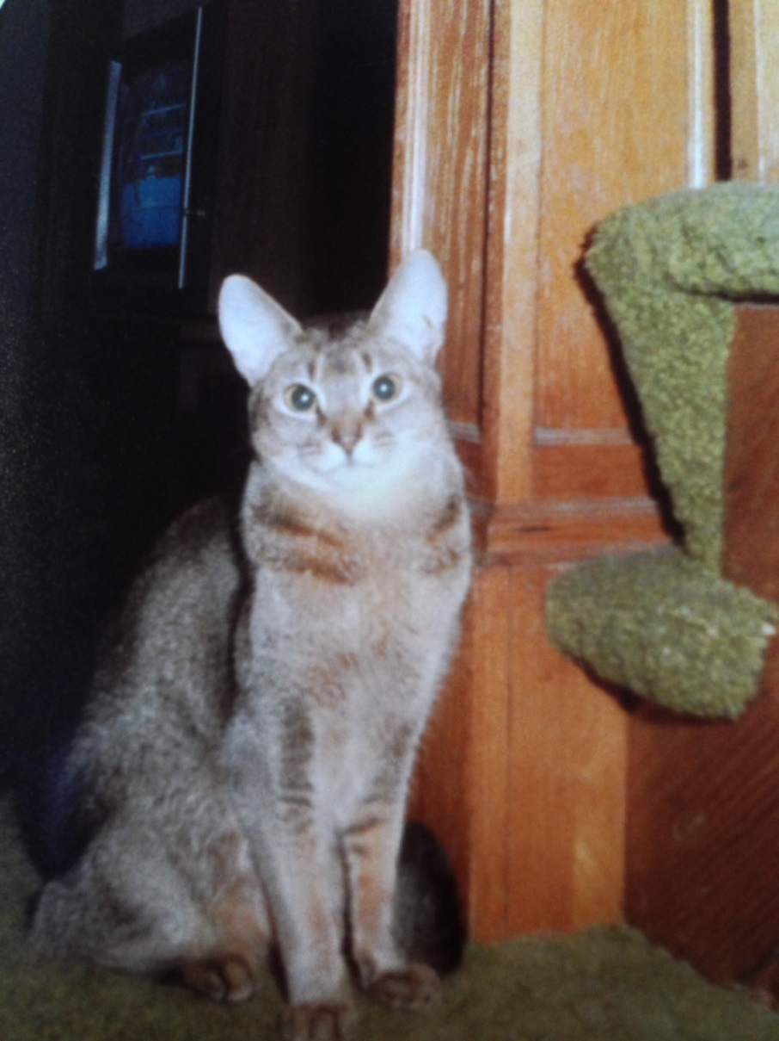
Broken necklace

Slide 90
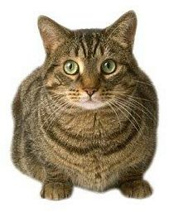
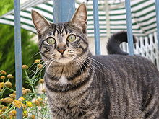
Withhold All Awards - Disqualify
Unbroken necklace
Reversed ticking
White locket
Notes:
Most white spots/lockets are found on the chest and neck area of the cat. Extreme caution must be taken to determine IF the white is an extension of the throat/neck white area - OR - if it is COMPLETELY separated and STANDS ALONE as a white area!! If it’s a “drip” it’s NOT a locket!

Slide 91
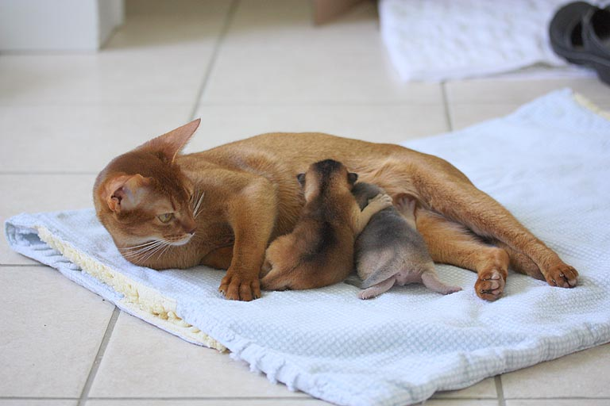
Colors
Traditional Division
Silver Division
Full Colors Dilute Colors
Ruddy Blue
Chocolate Lilac
Cinnamon Fawn
Silver Full Colors Silver Dilute Colors
Black Silver Blue Silver
Chocolate Silver Lilac Silver
Cinnamon Silver Fawn Silver
Cinnamon Mom with Ruddy and Blue kittens

Slide 92
Colors - Ruddy
Ruddy (traditional/usual)
Rich brown with black ticking, apricot undercolor, brick red nose leather and black paw pads

Slide 93
Colors
Cinnamon (previously sorrel/red but not sex-linked)
Coppery red with chocolate ticking, pink nose leather and pink paw pads.

Slide 94
Colors
Blue
Warm blue-grey with steel blue ticking
Dark pink nose leather
Mauve pink paw pads

Slide 95
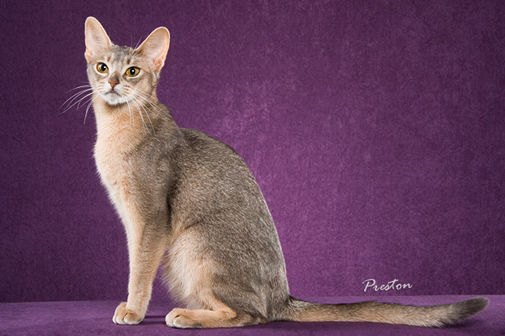
Colors - Blue

Slide 96
Colors - Fawn
Warm rose beige w/ pale cocoa ticking
Pinkish salmon nose leather
Pink paw pads

Slide 97
Colors
Silver
Not a new color
Seen back in the 1900s
Icy white closest to the skin followed by ticking of the appropriate eumelanistic color.
Lack of rufousing is more desirable

Slide 98
Breed Standard
Color
Silver Division
Icy white coat color closest to the skin accompanied by eumelanistic color ticking
Minor patches of rufousing are not considered a fault if the overall impression is that of a silver cat
Some rufousing may be seen along the spine & in areas of ticking – lack of rufousing is preferred

Slide 99
Colors – Black Silver

Slide 100
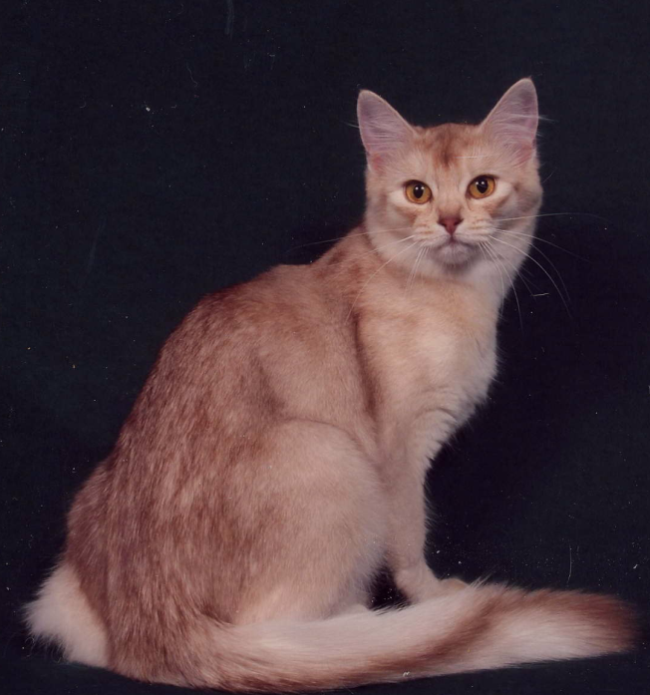
Colors – Cinnamon Silver

Slide 101
Penalties

Slide 102
Penalties
Color & Pattern Faults
“Mouse Coat” - Cold or gray coloration next to the skin
Distinct broken necklaces
Leg barring
Chest splotches, stripes or barring
Uneven ticking

Slide 103
Penalties
Condition
Flabbiness of body
Lack of coat luster
Emaciation / lack of muscle
Other: Pale eye color, round eyes

Slide 104
Withholds
Unbroken necklace
Reverse ticking – lacks the final dark tipping that is most easily seen in the absence of the dark spine line
White locket or white anywhere other than upper throat, chin, around nostrils & lips

Slide 105
Judging Techniques
Feather – the toy of choice, but rabbit fur teasers can compete. Actually anything will do!
Use the teaser to help you see them without manhandling too much
Feet on the table
Firm handling but not restrictive or they will fight to get away
Allow to climb the sisel poles
They are to be interactive with the environment – but they may not pay attention to you with all that goes on in the showhall.

Slide 106
Conclusion
As with any breed, the more educated and familiar you become with the breed, the more subtleties you will begin to notice.

